Slide 1
CYBERCRIMES: MOBILE AND WIRELESS
INTRODUCTION.
Why should mobile devices be protected? Every day, mobile devices are lost, stolen, and infected. Mobile devices can store important business and personal information, and are often be used to access University systems, email, banking
Page 1

Slide 2
Proliferation of mobile and wireless devices:
people hunched over their smartphones or tablets in cafes, airports, supermarkets and even at bus stops, seemingly oblivious to anything or anyone around them.
They play games, download email, go shopping or check their bank balances on the go.
They might even access corporate networks and pull up a document or two on their mobile gadgets
Today, incredible advances are being made for mobile devices. The trend is for smaller devices and more processing power. A few years ago, the choice was between a wireless phone and a simple PDA.
Page 2

Slide 3
Now the buyers have a choice between high-end PDAs with integrated wireless modems and small phones with wireless Web-browsing capabilities.
A long list of options is available to the mobile users. A simple hand-held mobile device provides enough computing power to run small applications, play games and music, and make voice calls. A key driver for the growth of mobile technology is the rapid growth of business solutions into hand-held devices.
As the term "mobile device" includes many products.
We first provide a clear distinction among the key terms: mobile computing, wireless computing and hand-held devices.
Page 3

Slide 4
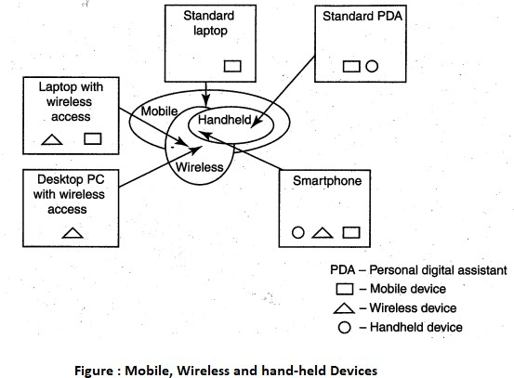
Figure
below helps us understand how these terms are related. Let us understand the concept of mobile computing and the various types of devices.
Mobile computing is "taking a computer and all necessary files and software out into the field." Many types of mobile computers have been introduced since 1990s. They are as follows:
1. Portable computer: It is a general-purpose computer that can be easily moved from one place to another, but cannot be used while in transit, usually because it requires some "setting-up" and an AC power source.
Page 4

Slide 5
Figure
below helps us understand how these terms are related. Let us understand the concept of mobile computing and the various types of devices.
Mobile computing is "taking a computer and all necessary files and software out into the field." Many types of mobile computers have been introduced since 1990s. They are as follows:
Portable computer: It is a general-purpose computer that can be easily moved from one place to another, but cannot be used while in transit, usually because it requires some "setting-up" and an AC power source.
Tablet PC: It lacks a keyboard, is shaped like a slate or a paper notebook and has features of a touchscreen with a stylus and handwriting recognition software. Tablets may not be best suited for applications requiring a physical keyboard for typing, but are otherwise capable of carrying out most tasks that an ordinary laptop would be able to perform.
Page 5

Slide 6
Internet tablet: It is the Internet appliance in tablet form. Unlike a Tablet PC, the Internet tablet does not have much computing power and its applications suite is limited. Also it cannot replace a general-purpose computer. The Internet tablets typically feature an MP3 and video player, a Web browser, a chat application and a picture viewer.
Personal digital assistant (PDA): It is a small, usually pocket-sized, computer with limited functionality. It is intended to supplement and synchronize with a desktop computer, giving access to contacts, address book, notes, E-Mail and other features..
Page 6

Slide 7
Ultramobile (PC): It is a full-featured, PDA-sized computer running a general-purpose operating system (OS).
Smartphone: It is a PDA with an integrated cell phone functionality. Current Smartphones have a wide range of features and installable applications.
Page 7

Slide 8
Carputer: It is a computing device installed in an automobile. It operates as a wireless computer, sound system, global positioning system (GPS) and DVD player. It also contains word processing software and is Bluetooth compatible.
Fly Fusion Pentop computer: It is a computing device with the size and shape of a pen. It functions as a writing utensil, MP3 player, language translator, digital storage device and calculator.
Page 8

Slide 9
Trends in Mobility:
Mobile computing is moving into a new era, generation which promises greater variety in applications and have highly improved usability as well as speedier networking. "iPhone" from Apple and Google-led "Android" phones are the best examples of this trend and there are plenty of other developments that point in this direction. This smart mobile technology is rapidly gaining popularity and the attackers (hackers and crackers) are among its biggest fans.
Page 9

Slide 10
It is worth noting the trends in mobile computing; this will help readers to readers to realize the seriousness of cybersecurity issues in the mobile computing domain. Figure below shows the different types of mobility and their implications.
Page 10

Slide 11
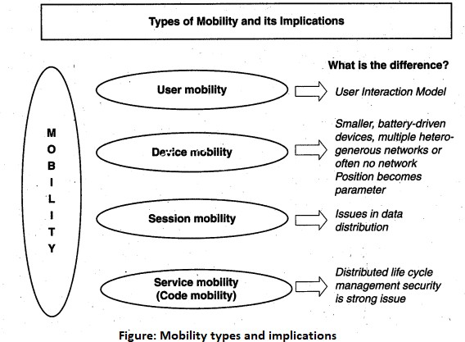
Page 11

Slide 12
Popular types of attacks against 3G mobile networks are as follows:
Malwares, viruses and worms:. Here are few examples of malware(s) specific to mobile devices:
Skull Trojan: I targets Series 60 phones equipped with the Symbian mobile OS.
Cabir Worm: It is the first dedicated mobile-phone worm infects phones running on Symbian OS and scans other mobile devices to send a copy of itself to the first vulnerable phone it finds through Bluetooth Wireless technology. The worst thing about this worm is that the source code for the Cabir-H and Cabir-I viruses is available online.
Page 12

Slide 13
Mosquito Trojan: It affects the Series 60 Smartphones and is a cracked version of "Mosquitos" mobile phone game.
Brador Trojan: It affects the Windows CE OS by creating a svchost. exe file in the Windows start-up folder which allows full control of the device. This executable file is conductive to traditional worm propagation vector such as E-Mail file attachments.
Page 13

Slide 14
Brador Trojan: It affects the Windows CE OS by creating a svchost. exe file in the Windows start-up folder which allows full control of the device. This executable file
is conductive to traditional worm propagation vector such as E-Mail file attachments.
Lasco Worm: It was released first in 2005 to target PDAs and mobile phones running the Symbian OS. Lasco is based on Cabir's source code and replicates over Bluetooth connection.
Page 14

Slide 15
Denial-of-service (DoS): The main objective behind this attack is to make the system unavailable to the intended users. Virus attacks can be used to damage the system to make the system unavailable. Presently, one of the most common cyber security threats to wired Internet service providers (iSPs) is a distributed denial-of-service (DDos) attack .DDoS attacks are used to flood the target system with the data so that the response from the target system is either slowed or stopped.
Page 15

Slide 16
Overbilling attack: Overbilling involves an attacker hijacking a subscriber's IP address and then using it (i.e., the connection) to initiate downloads that are not "Free downloads" or simply use it for his/her own purposes. In either case, the legitimate user is charged for the activity which the user did not conduct or authorize to conduct.
Spoofed policy development process (PDP): These of attacks exploit the vulnerabilities in the GTP [General Packet Radio Service (GPRS) Tunneling Protocol].
Signaling-level attacks: The Session Initiation Protocol (SIP) is a signaling protocol used in IP multimedia subsystem (IMS) networks to provide Voice Over Internet Protocol (VoIP) services. There are several vulnerabilities with SIP-based VolP systems.
Page 16

Slide 17
Credit Card Frauds in Mobile and Wireless Computing Era:
These are new trends in cybercrime that are coming up with mobile computing - mobile commerce (M-Commerce) and mobile banking (M-Banking).
Credit card frauds are now becoming commonplace given the ever-increasing power and the ever-reducing prices of the mobile hand-held devices, factors that result in easy availability of these gadgets to almost anyone.
Page 17

Slide 18
Today belongs to "mobile compüting," that is, anywhere anytime computing. The developments in wireless technology have fuelled this new mode of working for white collar workers.
This is true for credit card processing too; wireless credit card processing is a relatively new service that will allow a person to process credit cards electronically, virtually anywhere. Wireless credit card processing is a very desirable system, because it allows businesses to process transactions from mobile locations quickly, efficiently and professionally. It is most often used by businesses that operate mainly in a mobile environment
Page 18

Slide 19
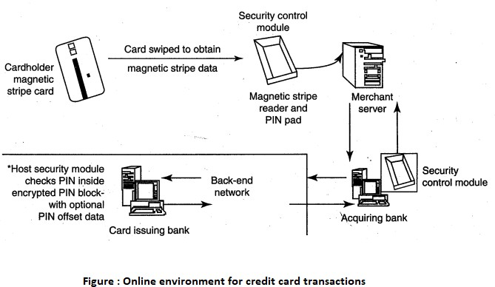
There is a system available from an Australian company "Alacrity" called closed-loop environment for for wireless (CLEW). Figure above shows the flow of events with CLEW which is a registered trademark of Alacrity used here only to demonstrate the flow in this environment.
As shown in Figure, the basic flow is as follows:
Merchant sends a transaction to bank
The bank transmits the request to the authorized cardholder
The cardholder approves or rejects (password protected)
Page 19

Slide 20
As shown in Figure, the basic flow is as follows:
Merchant sends a transaction to bank
The bank transmits the request to the authorized cardholder
The cardholder approves or rejects (password protected)
The bank/merchant is notified
The credit card transaction is completed.
Page 20

Slide 21
Security Challenges Posed by Mobile Devices:
Mobility brings two main challenges to cybersecurity: first, on the hand-held devices, information is being taken outside the physically controlled environment and second remote access back to the protected environment is being granted.
Perceptions of the organizations to these cybersecurity challenges are important in devising appropriate security operating procedure.
When people are asked about important in managing a diverse range of mobile devices, they seem to be thinking of the ones shown in below figure.
Page 21

Slide 22
As the number of mobile device users increases, two challenges are presented: one at the device level called "micro challenges" and another at the organizational level called "macro- challenges."
Some well-known technical challenges in mobile security are:
managing the registry settings and configurations,
authentication service security,
cryptography security,
Lightweight
media player control security,
networking application program interface (API), security etc.
Page 22

Slide 23
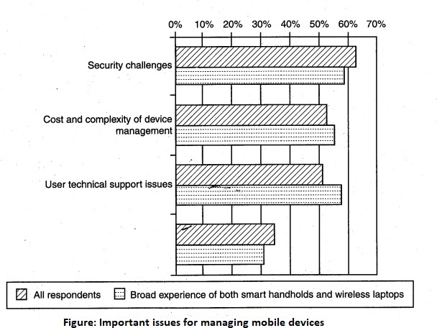
Page 23

Slide 24
Authentication Service Security:
There are two components of security in mobile computing: security of devices and security in networks. A secure network access involves authentication between the device and the base stations or Web servers. This is to ensure that only authenticated devices can be
Page 24

Slide 25
Attacks on Mobile-Cell Phones:
Mobile Phone Theft:
Mobile phones have become an integral part of everbody's life and the mobile phone has transformed from being a luxury to a bare necessity. Increase in the purchasing power and availability of numerous low cost handsets have also lead to an increase in mobile phone users. Theft of mobile phones has risen dramatically over the past few years. Since huge section of working population in India use public transport, major locations where theft occurs are bus stops, railway stations and traffic signals.
Enough target terminals: The first Palm OS virus was seen after the number of Palm OS devices reached 15 million. The first instance of a mobile virus was observed during June 2004 when it was discovered that an organization "Ojam" had engineered an antipiracy Trojan virus in older versions of their mobile phone game known as Mosquito. This virus sent SMS text messages to the organization without the users' knowledge. known as Mosquito. This virus sent SMS text messages to the organization without the users' knowledge.
Page 25

Slide 26
Enough functionality: Mobile devices are increasingly being equipped with office functionality and already carry critical data and applications, which are often protected insufficiently or not at all. The expanded functionality also increases the probability of malware.
Enough connectivity: Smartphones offer multiple communication options, such as SMS, MMS, synchronization, Bluetooth, infrared (IR) and WLAN connections. Therefore, unfortunately, the increased amount of freedom also offers more choices for virus writers.
Page 26

Slide 27
Organizational security Policies and Measures in Mobile Computing Era:
Proliferation of hand-held devices used makes the cybersecurity issue graver than what we would tend to think.
People have grown so used to their hand-helds they are treating them like wallets! For example, people are storing more types of confidential information on mobile computing devices than their employers or they themselves know; they listen to music using their-hand-held devices.
One should think about not to keep credit card and bank account numbers, passwords, confidential E-Mails and strategic information about organization, merger or takeover plans and also other valuable information that could impact stock values in the mobile devices.
Page 27

Slide 28
Operating Guidelines for Implementing Mobile Device Security Policies
In situations such as those described above, the ideal solution would be to prohibit all confidential data from being stored on mobile devices, but this may not always be practical. Organizations can, however, reduce the risk that confidential information will be accessed from lost or stolen mobile devices through the following steps:
Determine whether the employees in the organization need to use mobile computing devices at all, based on their risks and benefits within the organization, industry and regulatory environment.
Page 28

Slide 29
Implement additional security technologies, as appropriate to fit both the organization and the types of devices used. Most (and perhaps all) mobile computing devices will need to have their native security augmented with such tools as strong encryption, device passwords and physical locks. Biometrics techniques can be used for authentication and encryption and have great potential to eliminate the challenges associated with passwords.
Standardize the mobile computing devices and the associated security tools being used with them. As a matter of fundamental principle, security deteriorates quickly as the tools and devices used become increasingly disparate.
Page 29

Slide 30
Develop a specific framework for using mobile computing devices, including guidelines for data syncing, the use of firewalls and anti-malware software and the types of information that can be stored on them.
Centralize management of your mobile computing devices. Maintain an inventory so that you know who is using what kinds of devices.,
Establish patching procedures for software on mobile devices. This can often be simplified by integrating patching with syncing or patch management with the
centralized
Provide education and awareness training to personnel using mobile devices. People cannot be expected to appropriately secure their information if they have not been told how.
Page 30

Slide 31
Organizational Policies for the Use of Mobile Hand-Held Devices
There are many ways to handle the matter of creating policy for mobile devices. One way is creating distinct mobile computing policy.
Another way is including such devices existing policy.
There are also approaches in between where mobile devices fall under both existing policies and a new one.
In the hybrid approach, a new policy is created to address the specific needs of the mobile devices but more general usage issues fall under general IT policies.
As a part of this approach, the "acceptable use" policy for other technologies is extended to the mobile devices.
Page 31

Slide 32
Companies new to mobile devices may adopt an umbrella mobile policy but they find over time the the they will need to modify their policies to match the challenges posed by different kinds of mobile hand-held devices.
For example, wireless devices pose different challenges than non-wireless Also, employees who use mobile devices more than 20%% of the time will have different requirements than less-frequent users.
It may happen that over time, companies may need to create separate policies for the mobile devices on the basis of whether they connect wirelessly and with distinctions for devices that connect to WANs and LANs .
Page 32

Slide 33
Concept of Laptops:
As the price of computing technology is steadily decreasing, usage of devices such as the laptops is becoming more common.
Although laptops, like other mobile devices, enhance the business functions owing to their mobile access to information anytime and anywhere, they also pose a large threat as they are portable Wireless capability in these devices has also raised cyber security concerns owing to the information being transmitted over other, which makes it hard to detect.
Page 33

Slide 34
The thefts of laptops have always been a major issue, according to the cybersecurity industry and insurance company statistics.
Cybercriminals are targeting laptops that are expensive, to enable them to fetch a quick profit in the black market.
Very few laptop. thieves. are actually interested in the information that is contained in the laptop.
Most laptops contain personal and corporate information that could be sensitive..
Page 34

Slide 35
Cables and hardwired locks: The most cost-efficient and ideal solution to safeguard any mobile device is securing with cables and locks, specially designed for laptops.
Kensington cables are one of the most popular brands in laptop security cable. These cables are made of aircraft-grade steel and Kevlar brand fiber, thus making these cables 40%% stronger than any other conventional security cables.
One end of the security cable is fit into the universal security slot of the laptop and the other end is locked around any fixed furniture or item, thus making a loop. These cables come with a variety of options such as number locks, key locks and alarms.
Page 35

Slide 36
Laptop safes:
Safes made of polycarbonate - the same material that is used in bulletproof windows, police riot shields and bank security screens-can be used to carry and safeguard the laptops.
The advantage of safes over security cables is that they protect the whole laptop and its devices such as CD-ROM bays can be easily removed in the case of laptops protected by security cables.
Motion sensors and alarms:
Even though alarms and motion sensors are annoying owing to their false alarms and loud sound level, these devices are very efficient in securing laptops.
Once these devices are activated, they can be used to track missing laptops in crowded places.
Also owing to their loud nature, they help in deterring thieves.
Modern systems for laptops are designed wherein the alarm device attached to the laptop transmits radio signals to a certain range around the laptop.
Page 36

Slide 37
Warning labels and stamps:
Warning labels containing tracking information and identification details can be fixed onto the laptop to deter aspiring thieves.
These labels cannot be removed easily and are a low-cost solution to a laptop theft.
These labels have an identification number that is stored in a universal database for verification, which, in turn makes the resale of stolen laptops a difficult process. Such labels are highly recommended for the laptops issued to top executives and/or key employees of the organizations.
Page 37

Slide 38
Other measures for protecting laptops are as follows:
Engraving the laptop with personal details
Keeping the laptop close to oneself wherever possible
Carrying the laptop in a different and unobvious bag making it unobvious to potential thieves
Creating the awareness among the employees to understand the responsibility of carrying a laptop and also about the sensitivity of the information contained in the
laptop
Making a copy of the purchase receipt, laptop serial number and the description of the laptop
Page 38

Slide 39
Other measures for protecting laptops are as follows:
Installing encryption software to protect information stored on the laptop
Using personal firewall software to block unwanted access and intrusion
Updating the antivirus software regularly
Tight office security using security guards and securing the laptop by locking it down in lockers when not in use
Never leaving the laptop unattended in public places such as the car, parking lot, conventions, conferences and the airport until it is fitted with an anti theft device;
Page 39

Slide 40
A few logical or access controls are as follows:
Protecting from malicious programs/attackers/social engineering.
Avoiding weak passwords/ access.
Monitoring application security and scanning for vulnerabilities.
Ensuring that unencrypted data/unprotected file systems do not pose threats.
Proper handing of removable drives/storage mediums /unnecessary ports.
Password protection through appropriate passwords rules and use of strong passwords.
Locking down unwanted ports/devices.
Regularly installing security patches and updates.
Installing antivirus software/firewalls / intrusion detection system (IDSs).
Encrypting critical file systems.
Page 40

